Slide 1
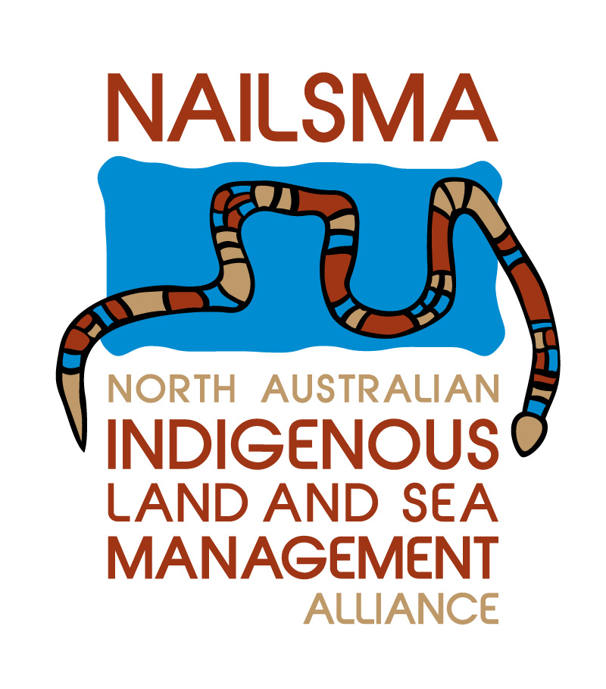
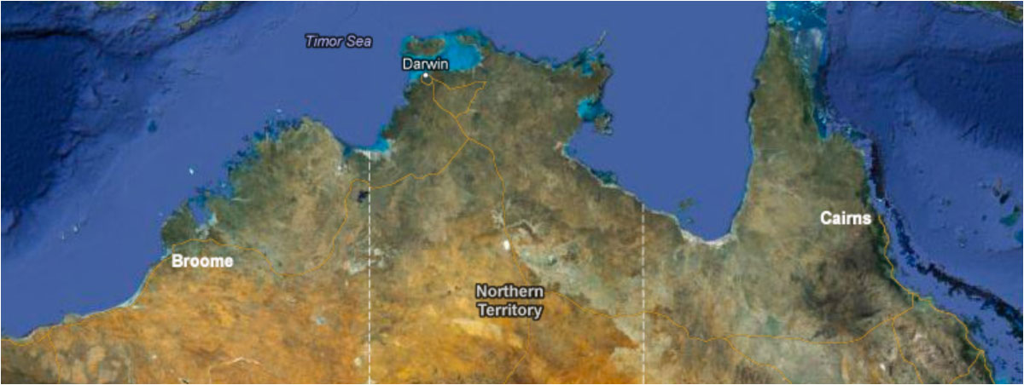
North Australian Indigenous Land and Sea Management Alliance Ltd (NAILSMA)
NAILSMA is an Indigenous-led not-for-profit company with a decade of experience delivering large-scale initiatives across north Australia.

Slide 2
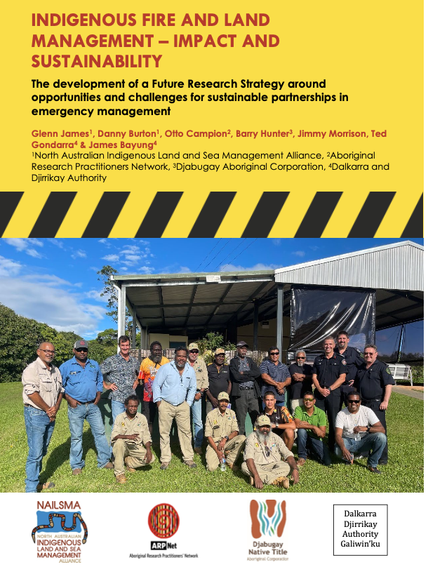
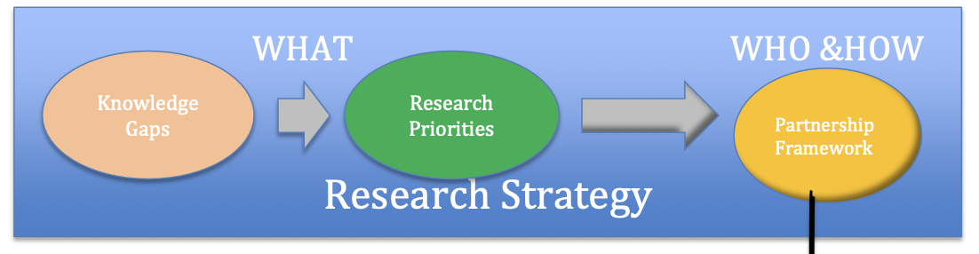
Response and Journey in search of research priorities and outcomes!

Slide 3
Partnerships and outcomes
Meetings of Gov agencies and Rep from rural and remote communities
2nd Meeting held in Qld
First ask the questions of Remote communities and EM
Next steps and develop framework for research and engagement
Onward - indigenous lead research
2019 2020 2021 2022 2012
Notes:
9 Groups took part in the Trial
Trial the LPA out on country, doing real work activities
Customised applications
High Priority Weeds, Ranger Names

Slide 4
Partnerships approach NAILSMA and Bushfire & Natural Hazard Research Australia
Research Priorities mirror the above gaps and challenges, leading to achieving practical steps in long-term relationship pathways:
  Detailed modelling of different approaches to sustainable involvement of Indigenous leaders and land management groups in EM partnership roles
  Cost benefit analysis of the different partner models to inform policy, operational change and short- and long-term Government EM budget planning.
  Reviewing laws and regulations to align with agreed partner roles, responsibilities and performance – e.g., State fire bans, fire lighting fines.
  Understanding the parameters of formal roles and responsibilities, decision making capabilities, cultural prohibitions/sensitivities, access rights etc. on different land tenure types (e.g., Aboriginal Freehold, Native Title, National Parks, Pastoral leases, town areas)
  Traditional Ecological Knowledge within emergency mitigation and response!

Slide 5
Looking after our country… and emergency response
to explore key issues and knowledge/capability gaps to develop a Future Research Strategy
to develop a Strategic Partnership Framework
to undertake a future Research Priorities Assessment
What will work and culturally appropriate
Indigenous lead research!
Cultural Fire credit encouraging burning of country and paid for externally as an offset!
• Explore the building blocks for future development of research and EM partnerships between Indigenous groups and Emergency Management Agencies in remote communities of the North
• For countrymen from the NT and NQld. to get together, share experiences, discuss priorities around EM and consider a strategic position on EM challenges and opportunities.

