Slide 1
Soil and fuel moisture precursors of fire activity during the 2019-2020 fire season
Paul Fox-Hughes, Marta Yebra^{2*}, Pandora Hope¹, Sugata Narsey¹, Shukhrat Shokirov², Francois Delage¹, Huqiang Zhang¹, Mika Peace¹, Andrew Dowdy¹, Vinod Kumar¹
¹Bureau of Meteorology, ²Australian National University
*Director, ANU-Optus Bushfire Research Centre of Excellence
Mission Specialist, Institute for Space
Fenner School of Environment and Society, School of Engineering
^{@myebra12}
; marta.yebra@anu.edu.au

Slide 2
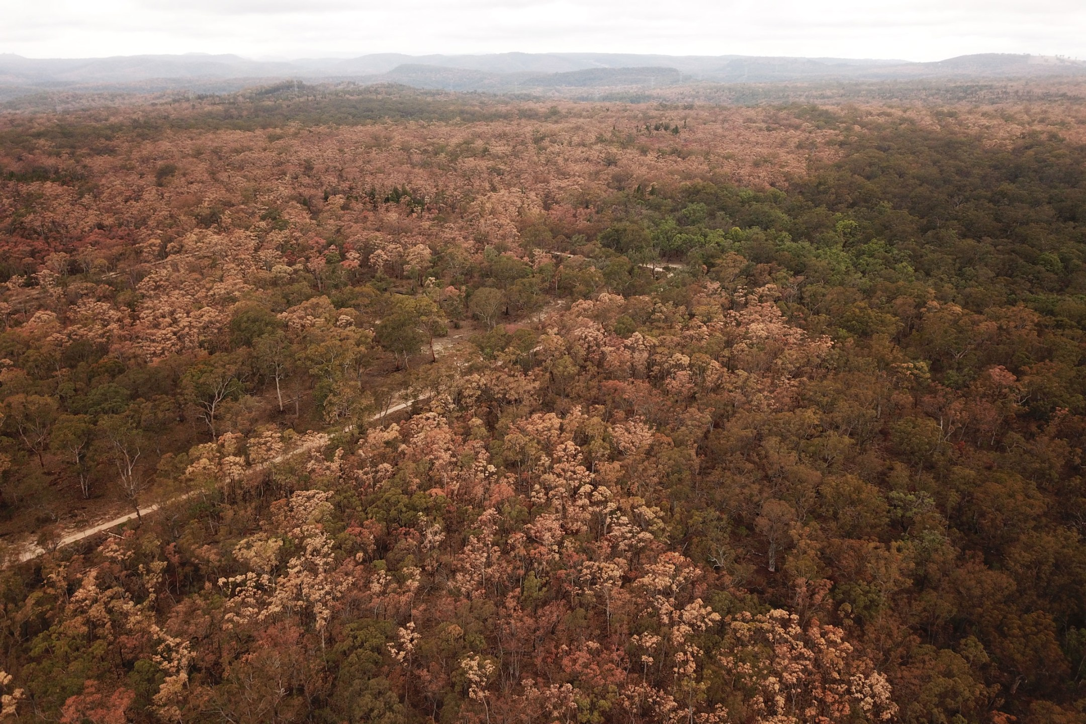
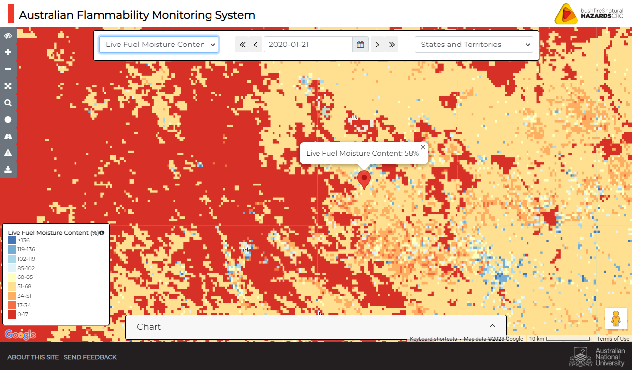
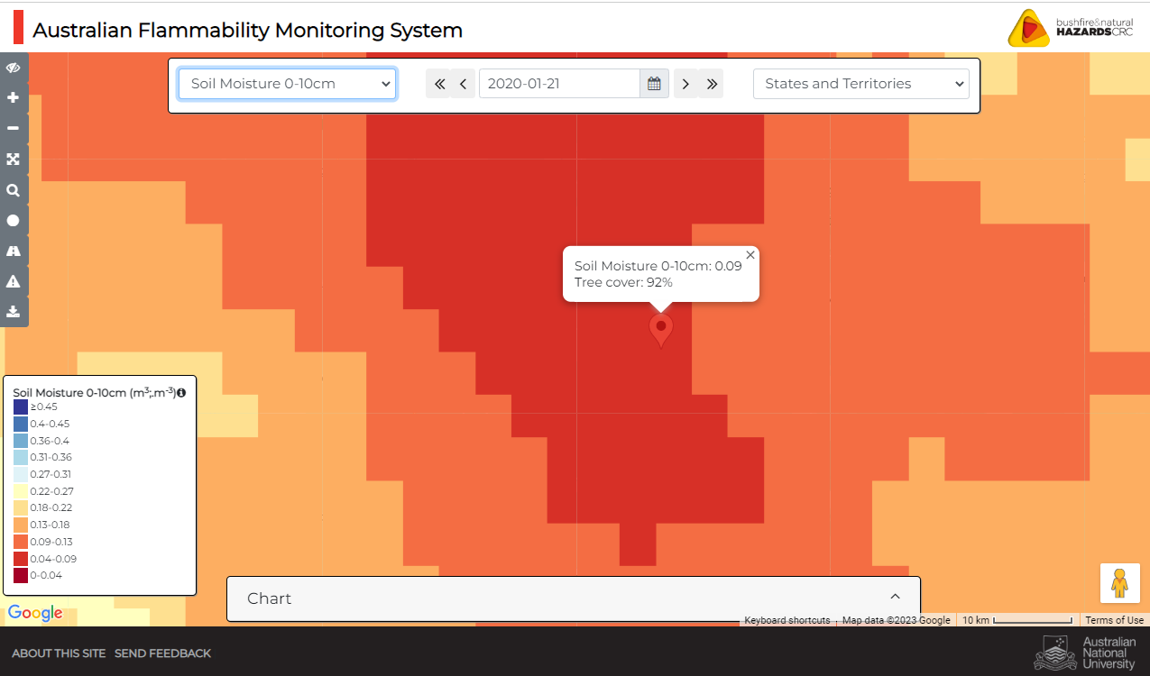
Mass canopy dieback event at Kain’s Flat near Mudgee NSW
Lat, Lon: 32.4723095 , 149.8822149
“These shot was taken in 19/1/2020 - it is looking in one direction - all other directions look much the same with dead trees” Matt Herbert
Source: The Dead Tree Detective
@Matt Herbert
http://wenfo.org/afms/

Slide 3
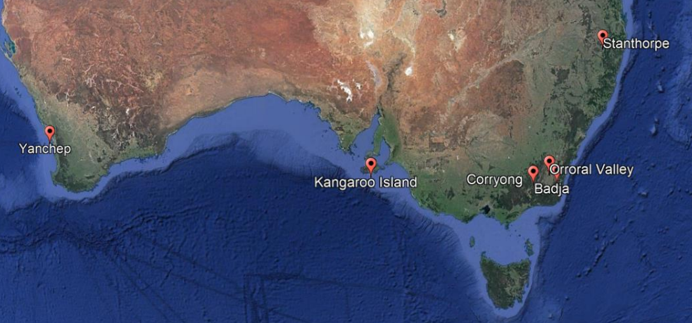
What factors contributed to severity of Black Summer?
Six fires across Australia
Investigate soil/fuel/weather parameters
Over scales of days, weeks, months and years

Slide 4
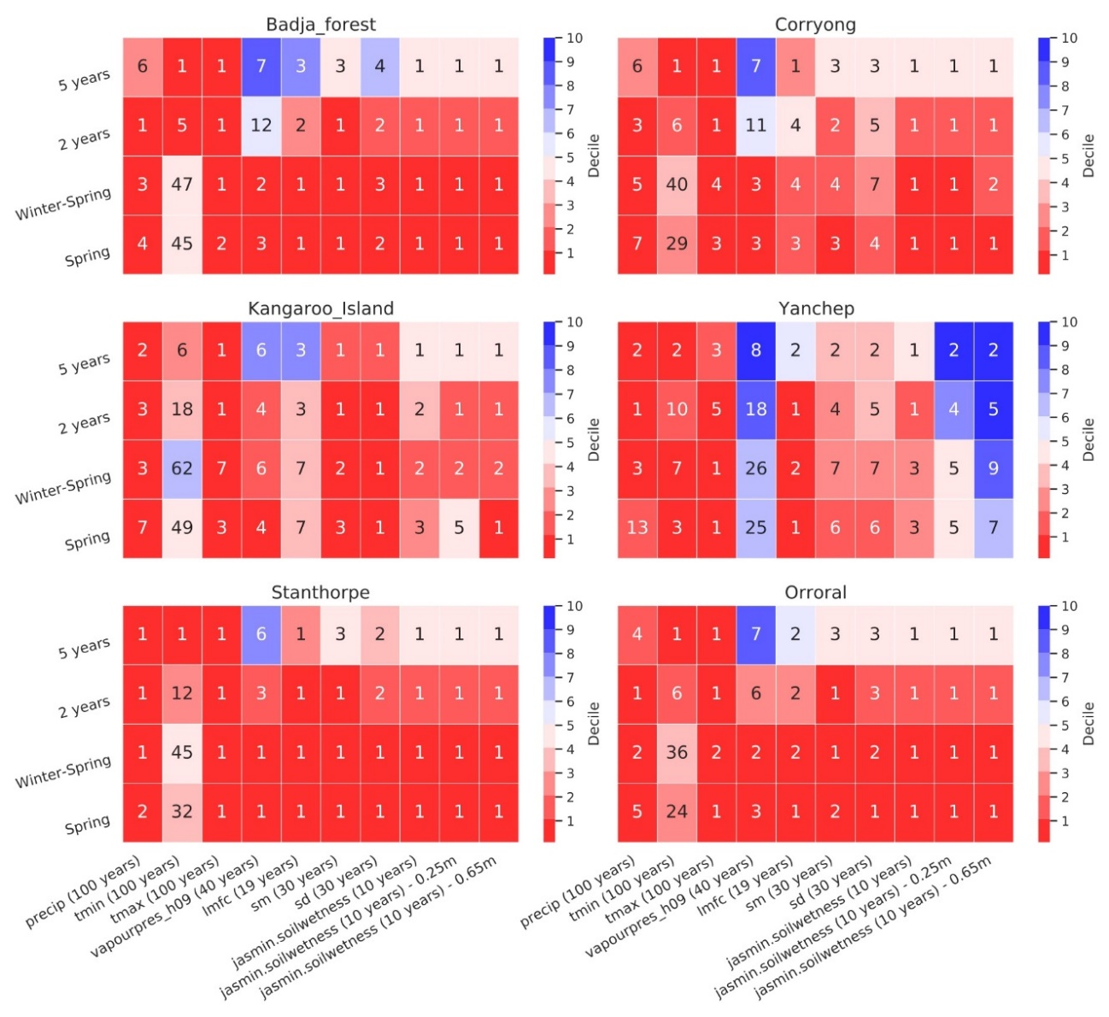
Worst conditions on records at different timescales
Summary of decile values of meteorological parameters and soil and fuel moisture content for each of the six fires investigated.
Note: Top right hand corner less significant due short data history and long averaging

Slide 5
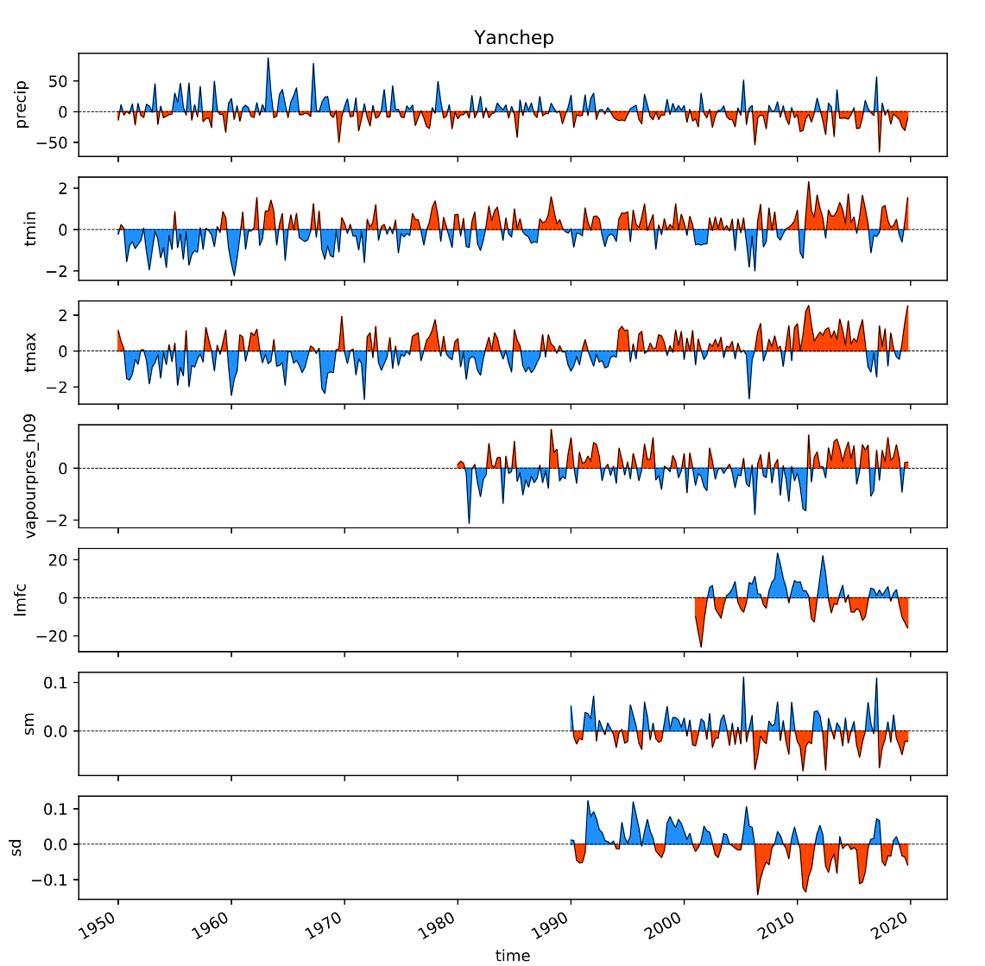
Multiyear development of conditions that favour bushfires
Meteo
11 December 2019
LFMC
Time series of 3-monthly anomalies of meteorological variables and soil and fuel moisture averaged over Yanchep fire ground
Soil moisture

Slide 6
Live fuel moisture content better discriminant of potential fire conditions than soil moisture
Fire
Soil moisture
Fire

Slide 7
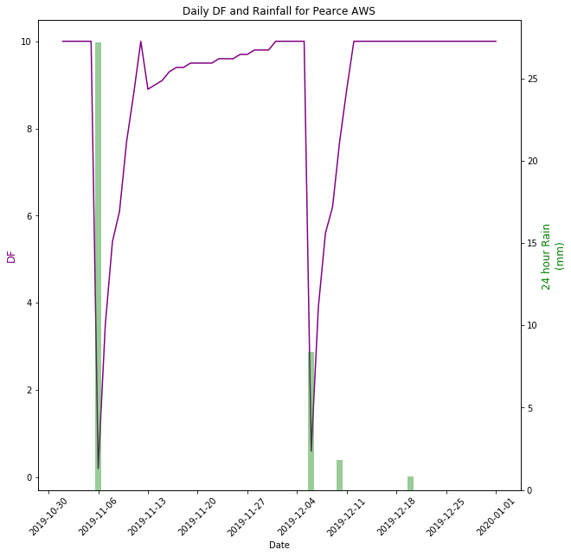
Drought Factor has limited representation of moisture deficit in the drier conditions
Yanchep
Drought factor
24 hour Rain (mm)
Data from Pearce Automatic Weather Station

Slide 8
Heat waves associated with a decrease in live fuel moisture content
Excess Heat Factor (EHF) is used as an indicator of the presence of heatwaves

Slide 9
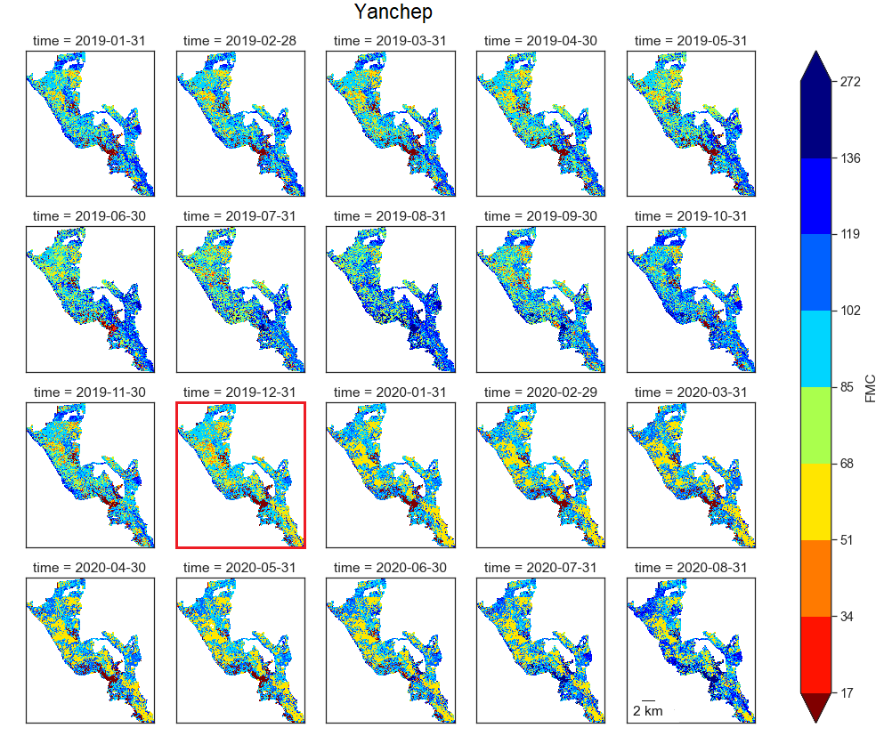
Spatial variability in LFMC within firegrounds
Attempting to discern decline in "soft boundaries" as gullies dry out
Fire

Slide 10
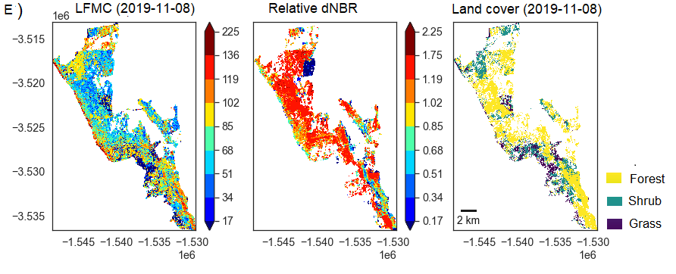
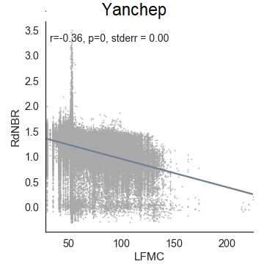
Pre-fire FMC is negatively correlated to fire severity
(Fire severity)

Slide 11
Considerations for fire managers
Successive years of dry conditions can lead to dramatic downward changes in live fuel moisture content and thus heightened fire risk
Fuel moisture can rapidly decrease coinciding with heatwaves
Live fuel moisture content provided the most immediate indicator of present fire risk. Soil moisture content permitted an assessment of future changes in fuel moisture content. Both of these integrated changes in meteorological parameters.

Slide 12
Opportunities of research to better estimate fire risk
Understand the nature and quantity of the interactions between the variables examined.
Stablishing links between heatwaves and fire risk resulting from changes in fuel moisture content
Further investigate differences in FMC at a finer detail across the landscape
Consideration of dead fuel moisture to develop a complete assessment of fuel availability.
Incorporate soil and live fuel moisture content in the Australian Fire Danger Rating System (AFDRS) to represent conditions under which live fuels are also available to burn → urgent under climate change.

Slide 13
Thank you
Bushfire and Natural Hazards Co-operative Research Centre
WA DFES
Jackson Parker, Agnes Kristina
WA DBCA
Lachie McCaw, Valerie Densmore
SA DEW
Simeon Telfer
Vic DEWLP
Anthony Cheesman
ACT Parks
Adam Leavesley
NSW RFS
Laurence McCoy
David Field
QFES
Ray Bott
Russell Stephens-Peacock
Owen Salkin
Natural Systems Analytics

